Slide 1
机器学习算法之SVM精讲

Slide 2
SVM
Kernel Method and beyond

Slide 19
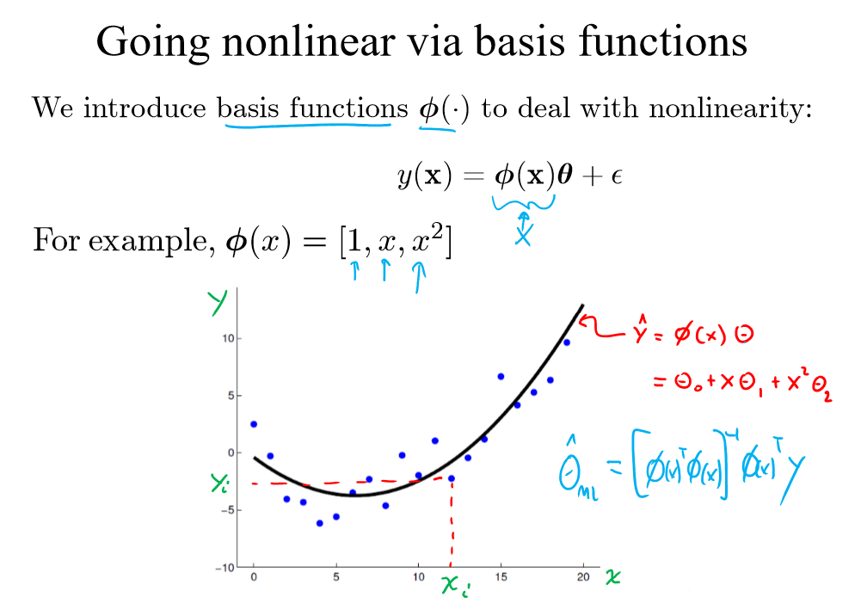

Slide 20
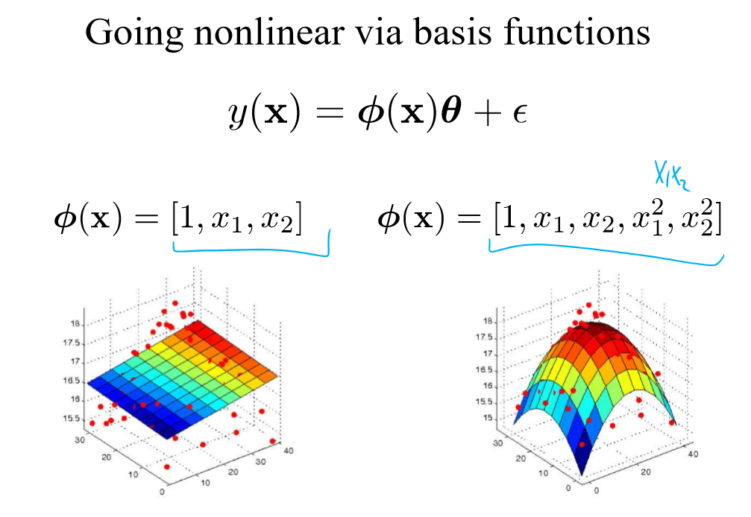

Slide 21
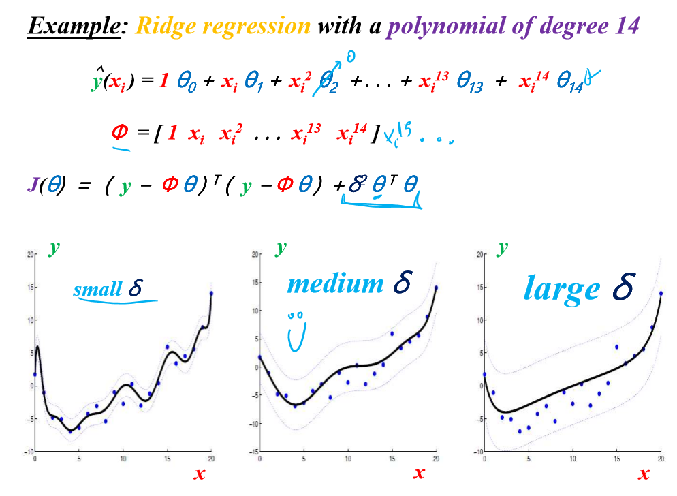

Slide 22
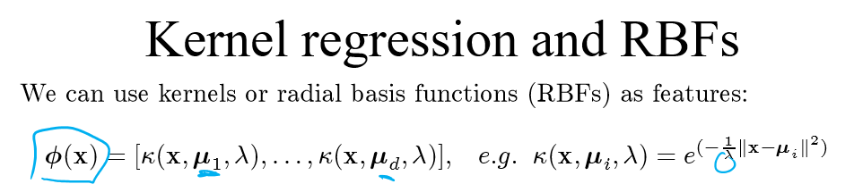

Slide 23
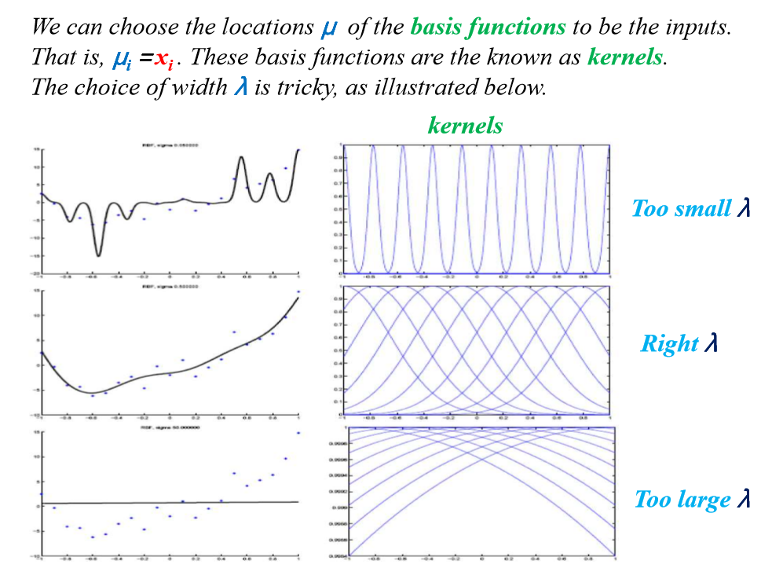

Slide 24
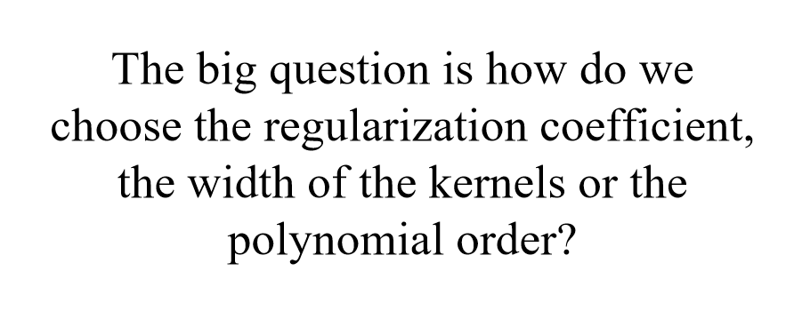

Slide 25
Holdout Evaluation I

Slide 26
Holdout Evaluation II

Slide 27
Holdout Validation I

Slide 28
Holdout Validation II

Slide 29
Holdout Validation III

Slide 30
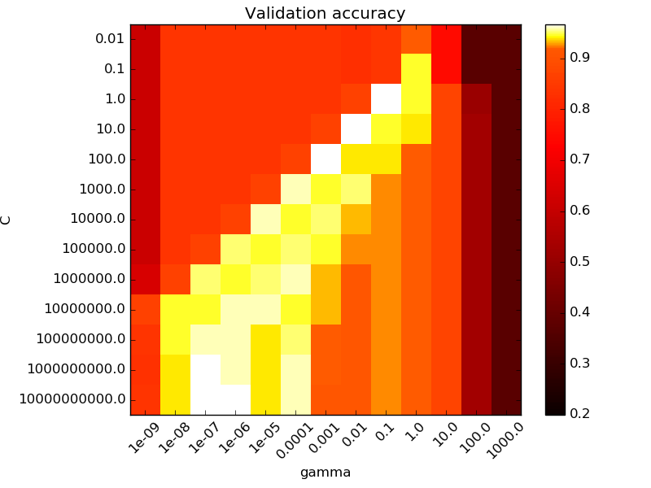
Grid Search
C parameter
gamma parameter

